Slide 1
Counting the Number of Red Blood Cells and their Circularity
Presented by Satyam Agrawal

Slide 2
Contents
Objective of the Analysis
Counting the number of RBCs
Approach
Step 1 - Annotation of Images
Step 2 - Preprocessing the Image
Step 3 - Contour Based Segmentation
Step 4 - Comparison of methods
Step 5 - Watershed Algorithm on RGB Channels
Conclusion
Presented by Satyam Agrawal

Slide 3
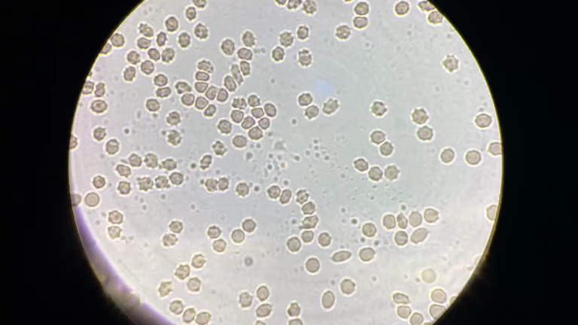
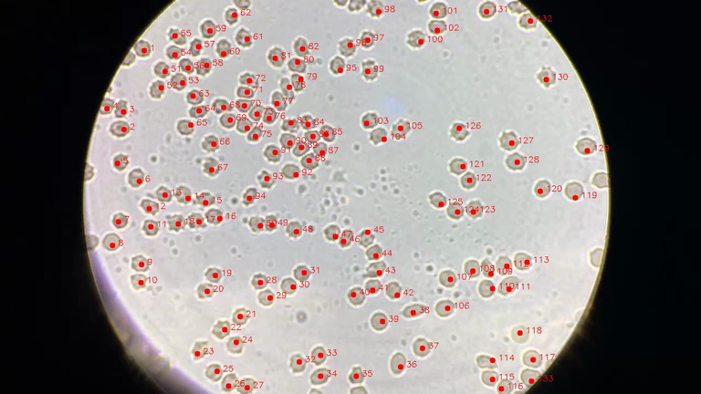
Objective
Develop and test methods to -
Count the number of RBCs in an image
Determine the circularity of the cells
Presented by Satyam Agrawal

Slide 4
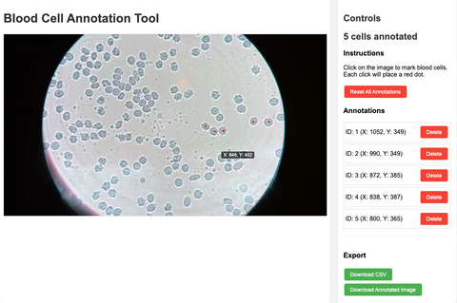
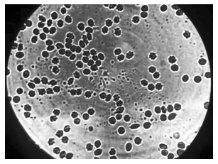

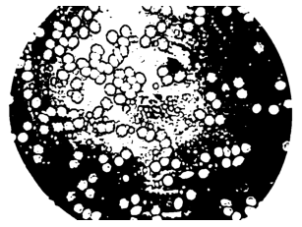
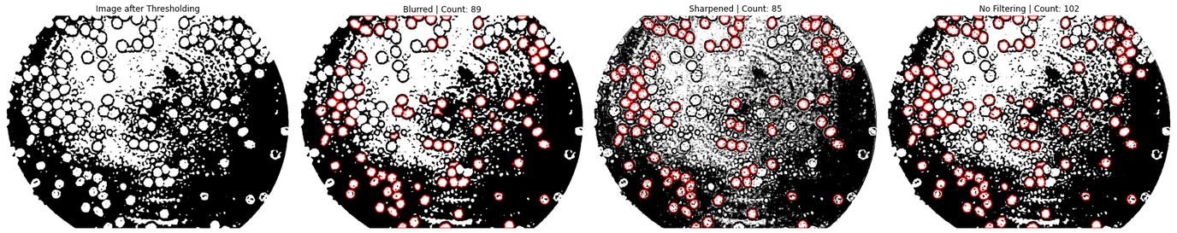
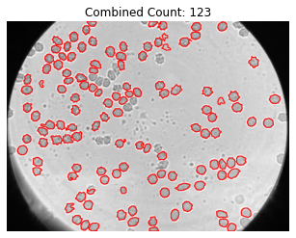
Counting the number of RBCs - Approach
Original Video
Frames
Annotation
Preprocessing
Binary Thresholding
Contour Detection
Union of Approaches
Presented by Satyam Agrawal

Slide 5
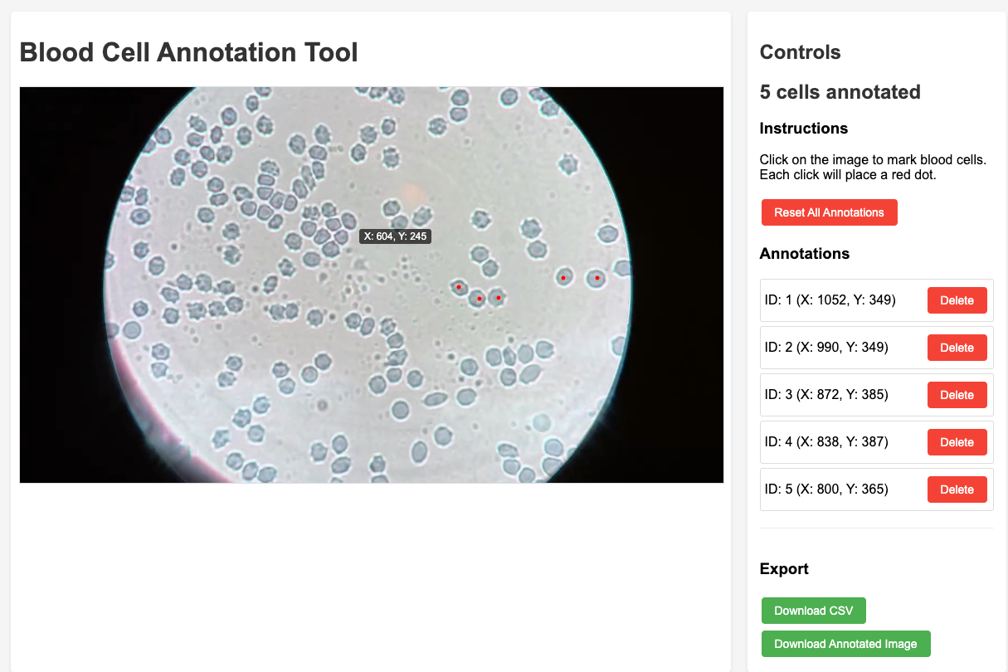
Annotation of Images
Presented by Satyam Agrawal

Slide 6
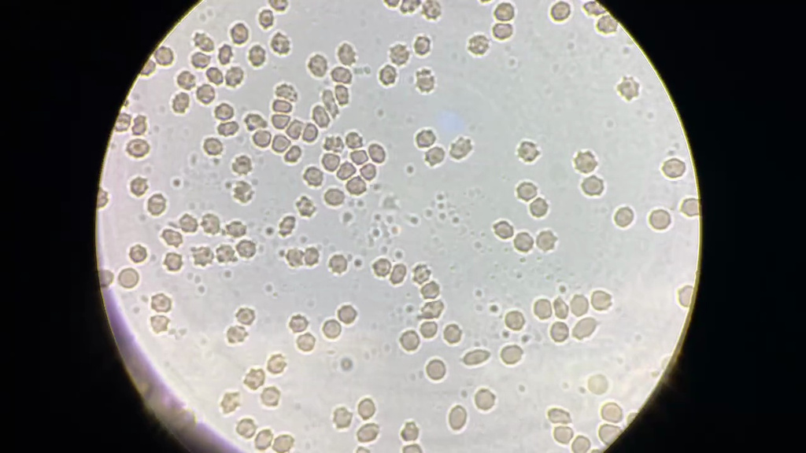

Annotation of Images
Raw Image
Annotated Image (133 RBCs)
Presented by Satyam Agrawal

Slide 7
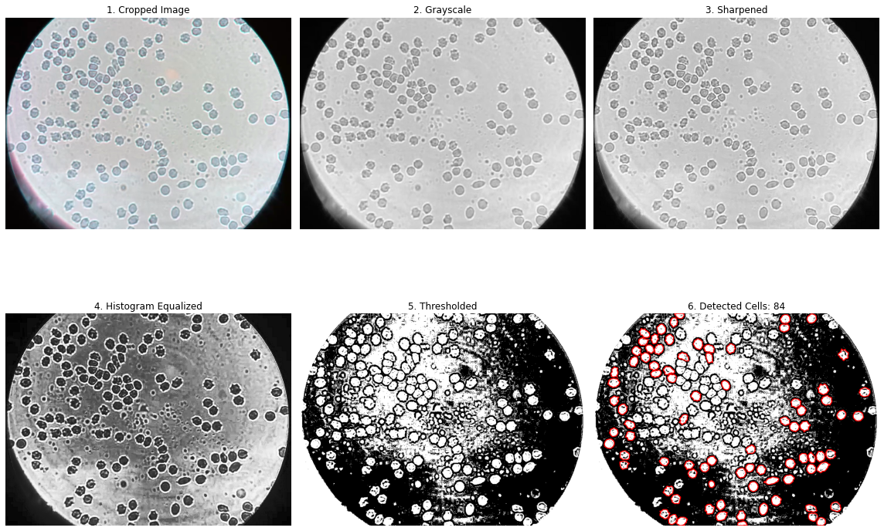
Preprocessing
Presented by Satyam Agrawal

Slide 8
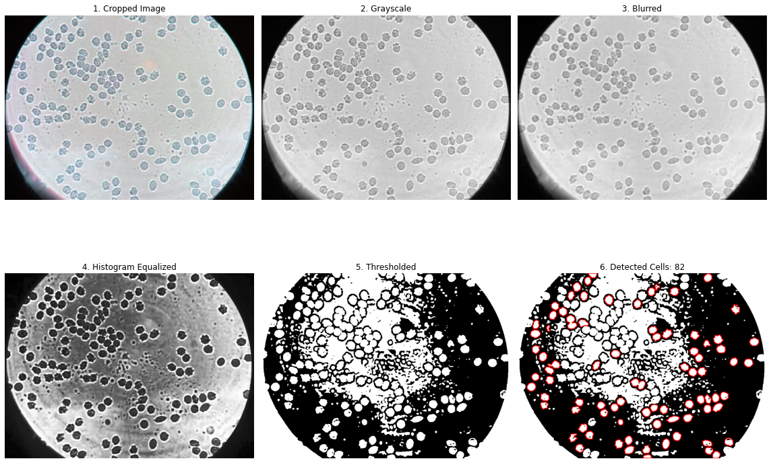
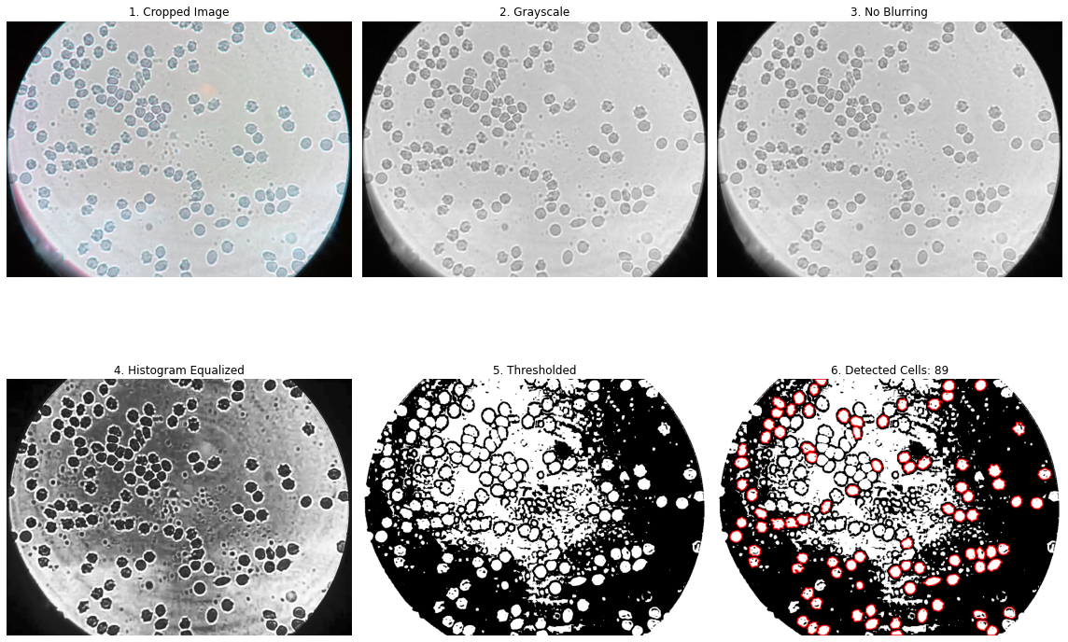
Preprocessing
Presented by Satyam Agrawal

Slide 9
Preprocessing
Presented by Satyam Agrawal

Slide 10
Binary Thresholding
Presented by Satyam Agrawal

Slide 11
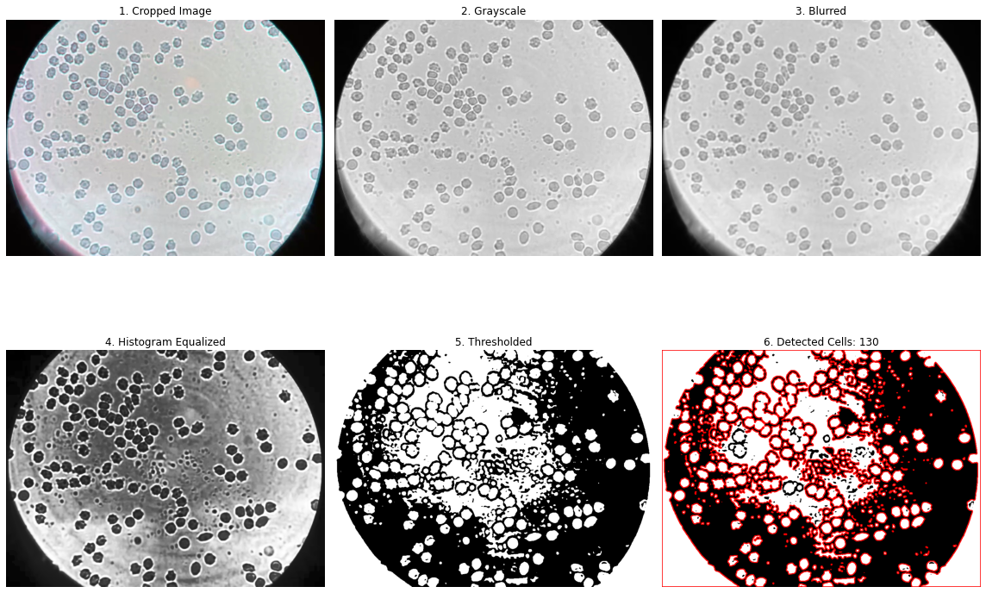
Contour Detection
Clustering of Contours
Non-Linear Contours
Presented by Satyam Agrawal

Slide 12
Contour Detection
Constraints on the Contour:
Minimum Size
Maximum Size
Circularity
Presented by Satyam Agrawal

Slide 13
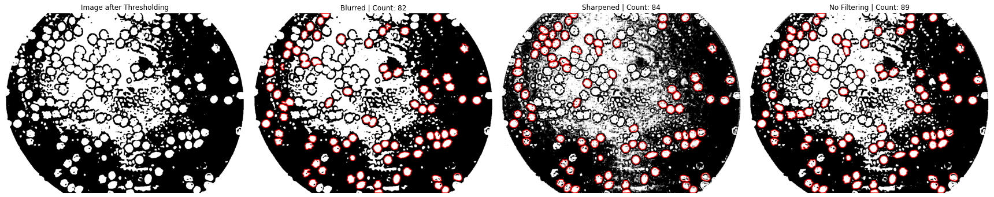
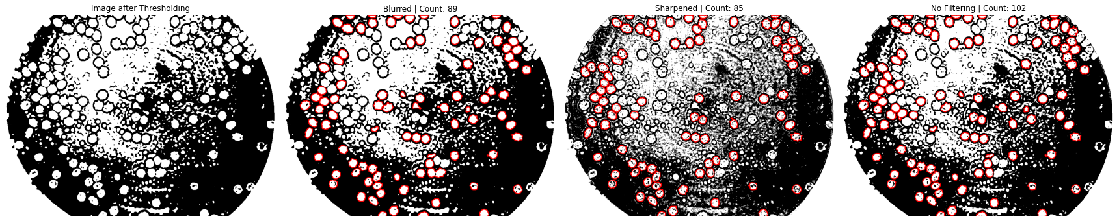
Contour Detection
Presented by Satyam Agrawal

Slide 14
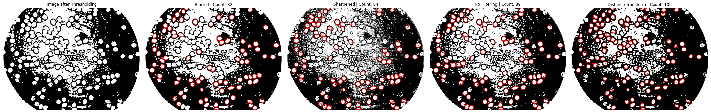
Distance Transform
Presented by Satyam Agrawal

Slide 15
Union of Approaches
Result after taking Union of Approaches
Combined Count = 123 compared to the gold annotation of 133 RBCs.
However, on manual inspection, we can see around 15 False Negatives and around 5 False Positives.
Watershed Algorithm to segment was tested to try and solve this gap.
Presented by Satyam Agrawal

Slide 16
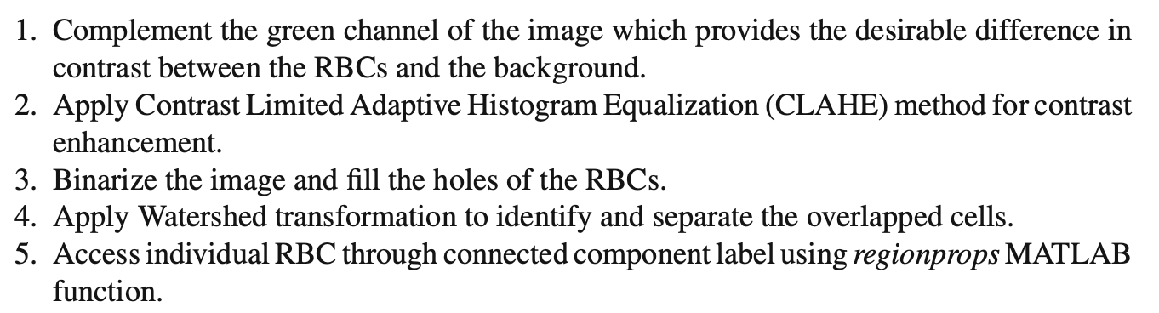
Channel Wise - Watershed Algorithm
-- Navya K. T., Nihar Prakash, Keerthana Prasad, Brij Mohan Kumar Singh, Red blood cell segmentation and classification using hybrid image processing–SqueezeNet model.
Presented by Satyam Agrawal

Slide 17
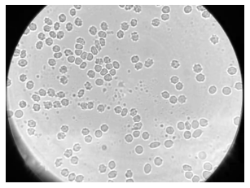
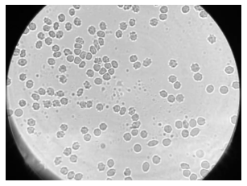
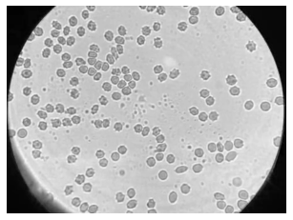
Channel Wise - Watershed Algorithm
R
G
B
Presented by Satyam Agrawal

Slide 18
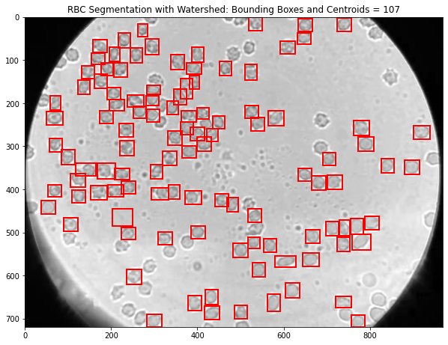
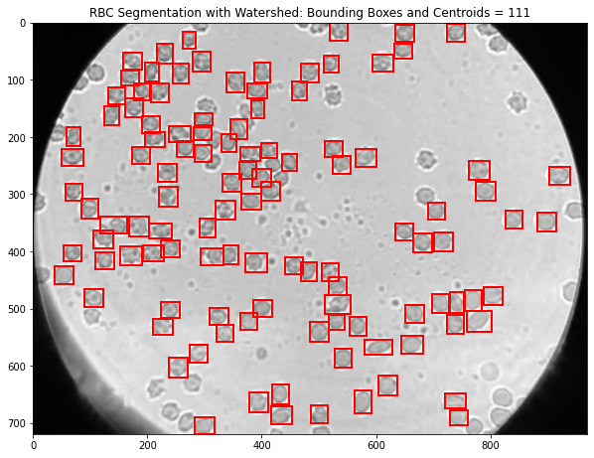
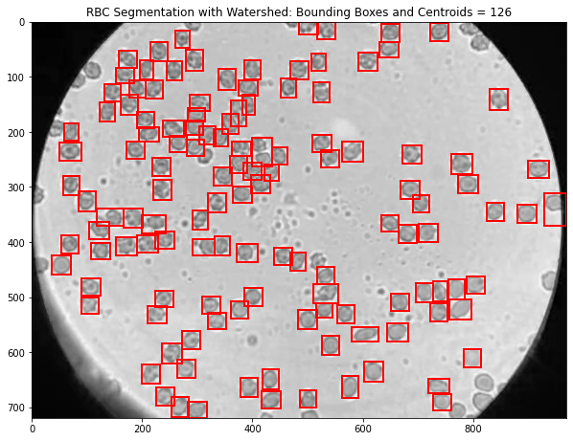
Channel Wise - Watershed Algorithm
R-107
G-111
B-126
Presented by Satyam Agrawal

Slide 19
Channel Wise - Watershed Algorithm
Result after Watershed Algorithm on the Blue Channel
Combined Count = 126 compared to the gold annotation of 133 RBCs.
On manual inspection, we can see around 6 False Negatives and 0 False Positives.
Presented by Satyam Agrawal

Slide 20
Conclusion
What We Did
Developed a UI interface for annotating images
Annotated a few RBC images for testing purposes
Applied preprocessing, binary thresholding, and contour-based segmentation
Combined multiple approaches to improve accuracy
Tested the Watershed Algorithm across RGB channels
Presented by Satyam Agrawal

Slide 21
Conclusion
What Worked Best
Watershed Algorithm on the Blue Channel
Detected 126 RBCs
Only 6 false negatives, 0 false positives
Why It Worked
Blue channel gave best contrast between RBCs and background
Enabled clearer boundary separation during segmentation
Significantly reduced noise and overlap errors
Use of LED illumination likely enhanced blue channel clarity
Presented by Satyam Agrawal

Slide 22
Future Work
Create a fully annotated dataset for robust evaluation
Explore deep learning-based approaches for segmentation and counting
Utilise Hyperspectral information to pave way for spectral based techniques for counting RBCs
Presented by Satyam Agrawal

